Slide 1
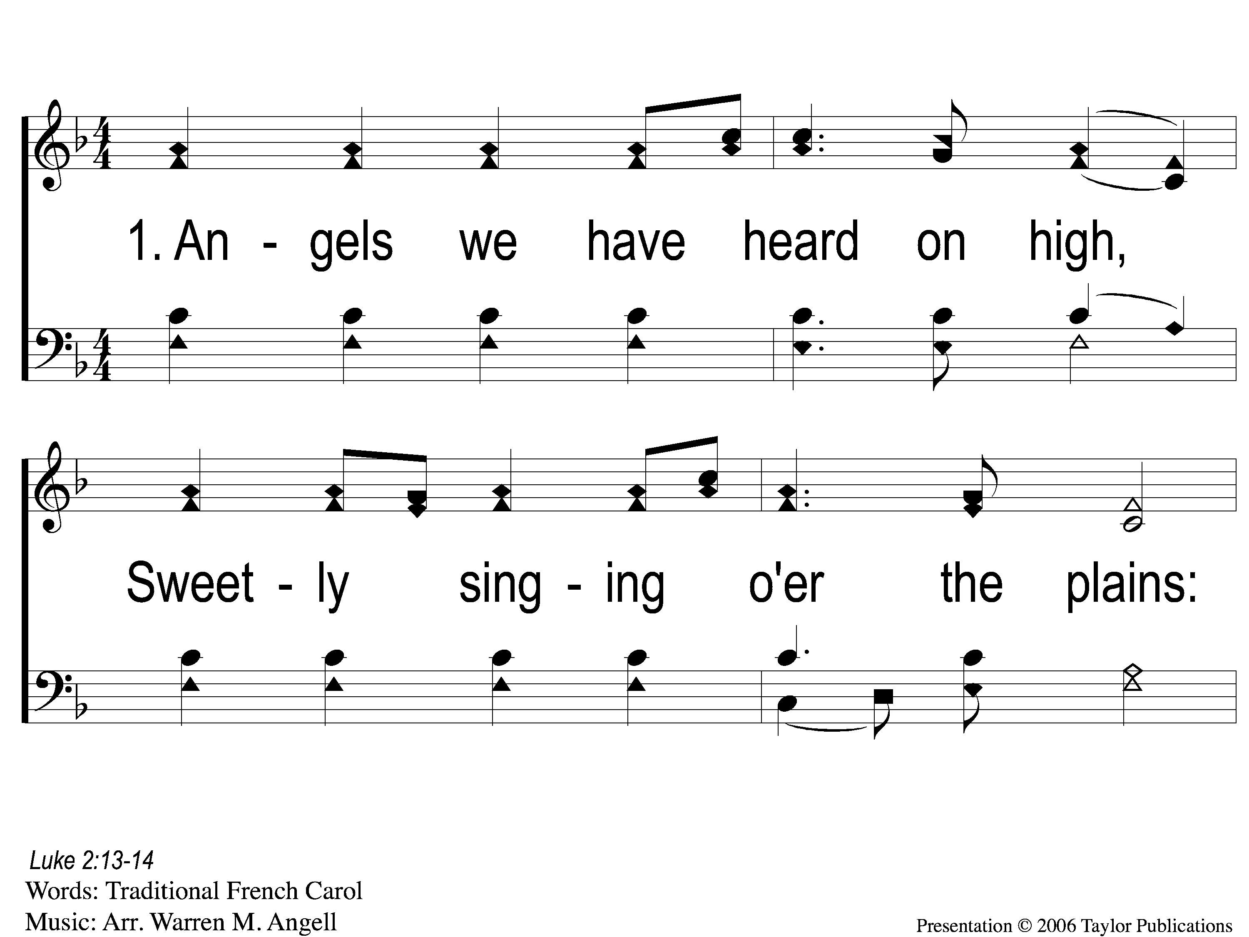
1-1 Angels We Have Heard On High
Angels We Have Heard On High
1002

Slide 2
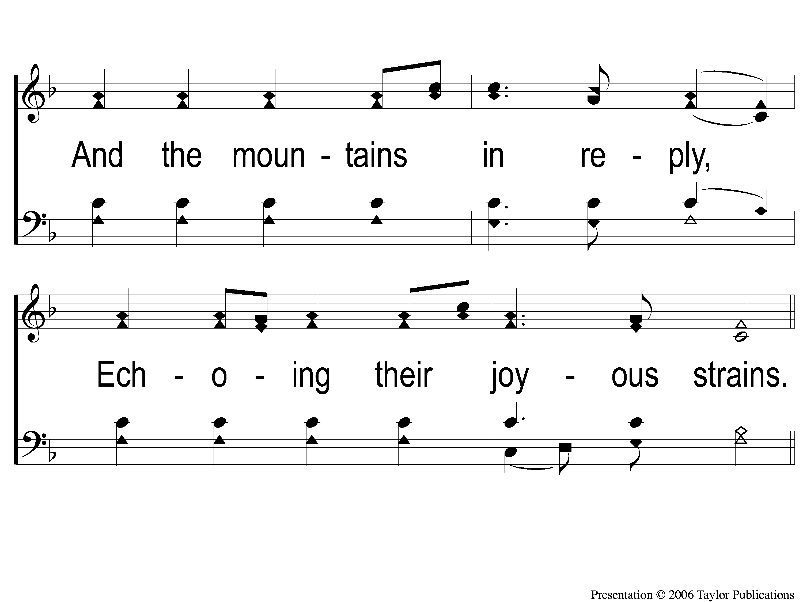
1-2 Angels We Have Heard On High
Angels We Have Heard On High
1002

Slide 3
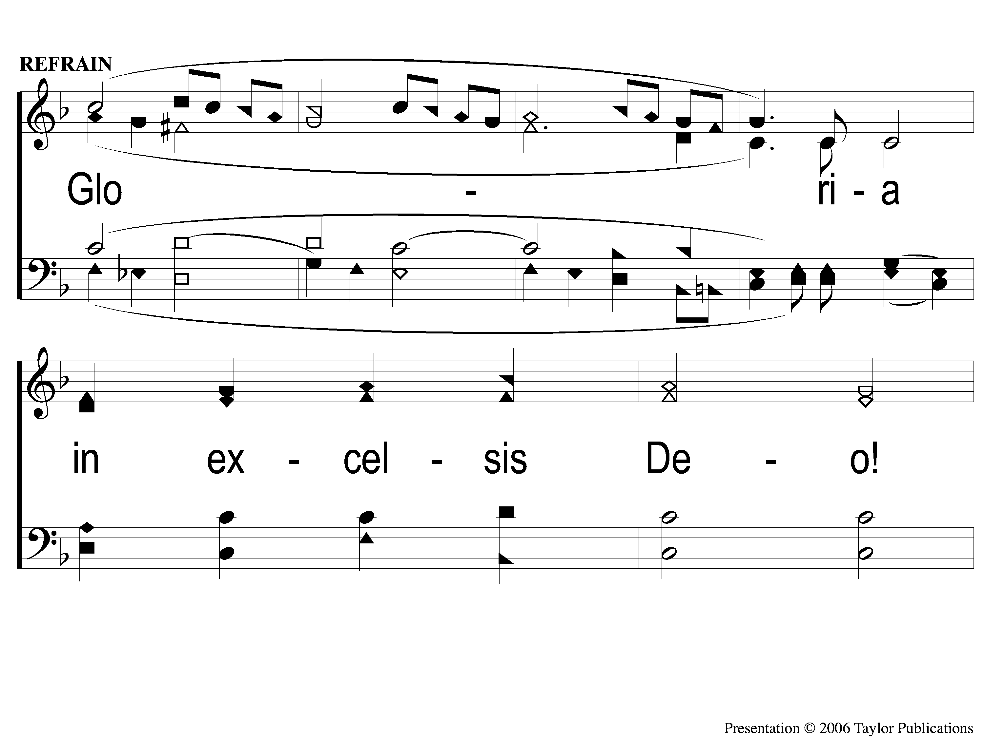
C-1 Angels We Have Heard On High
Angels We Have Heard On High
1002

Slide 4
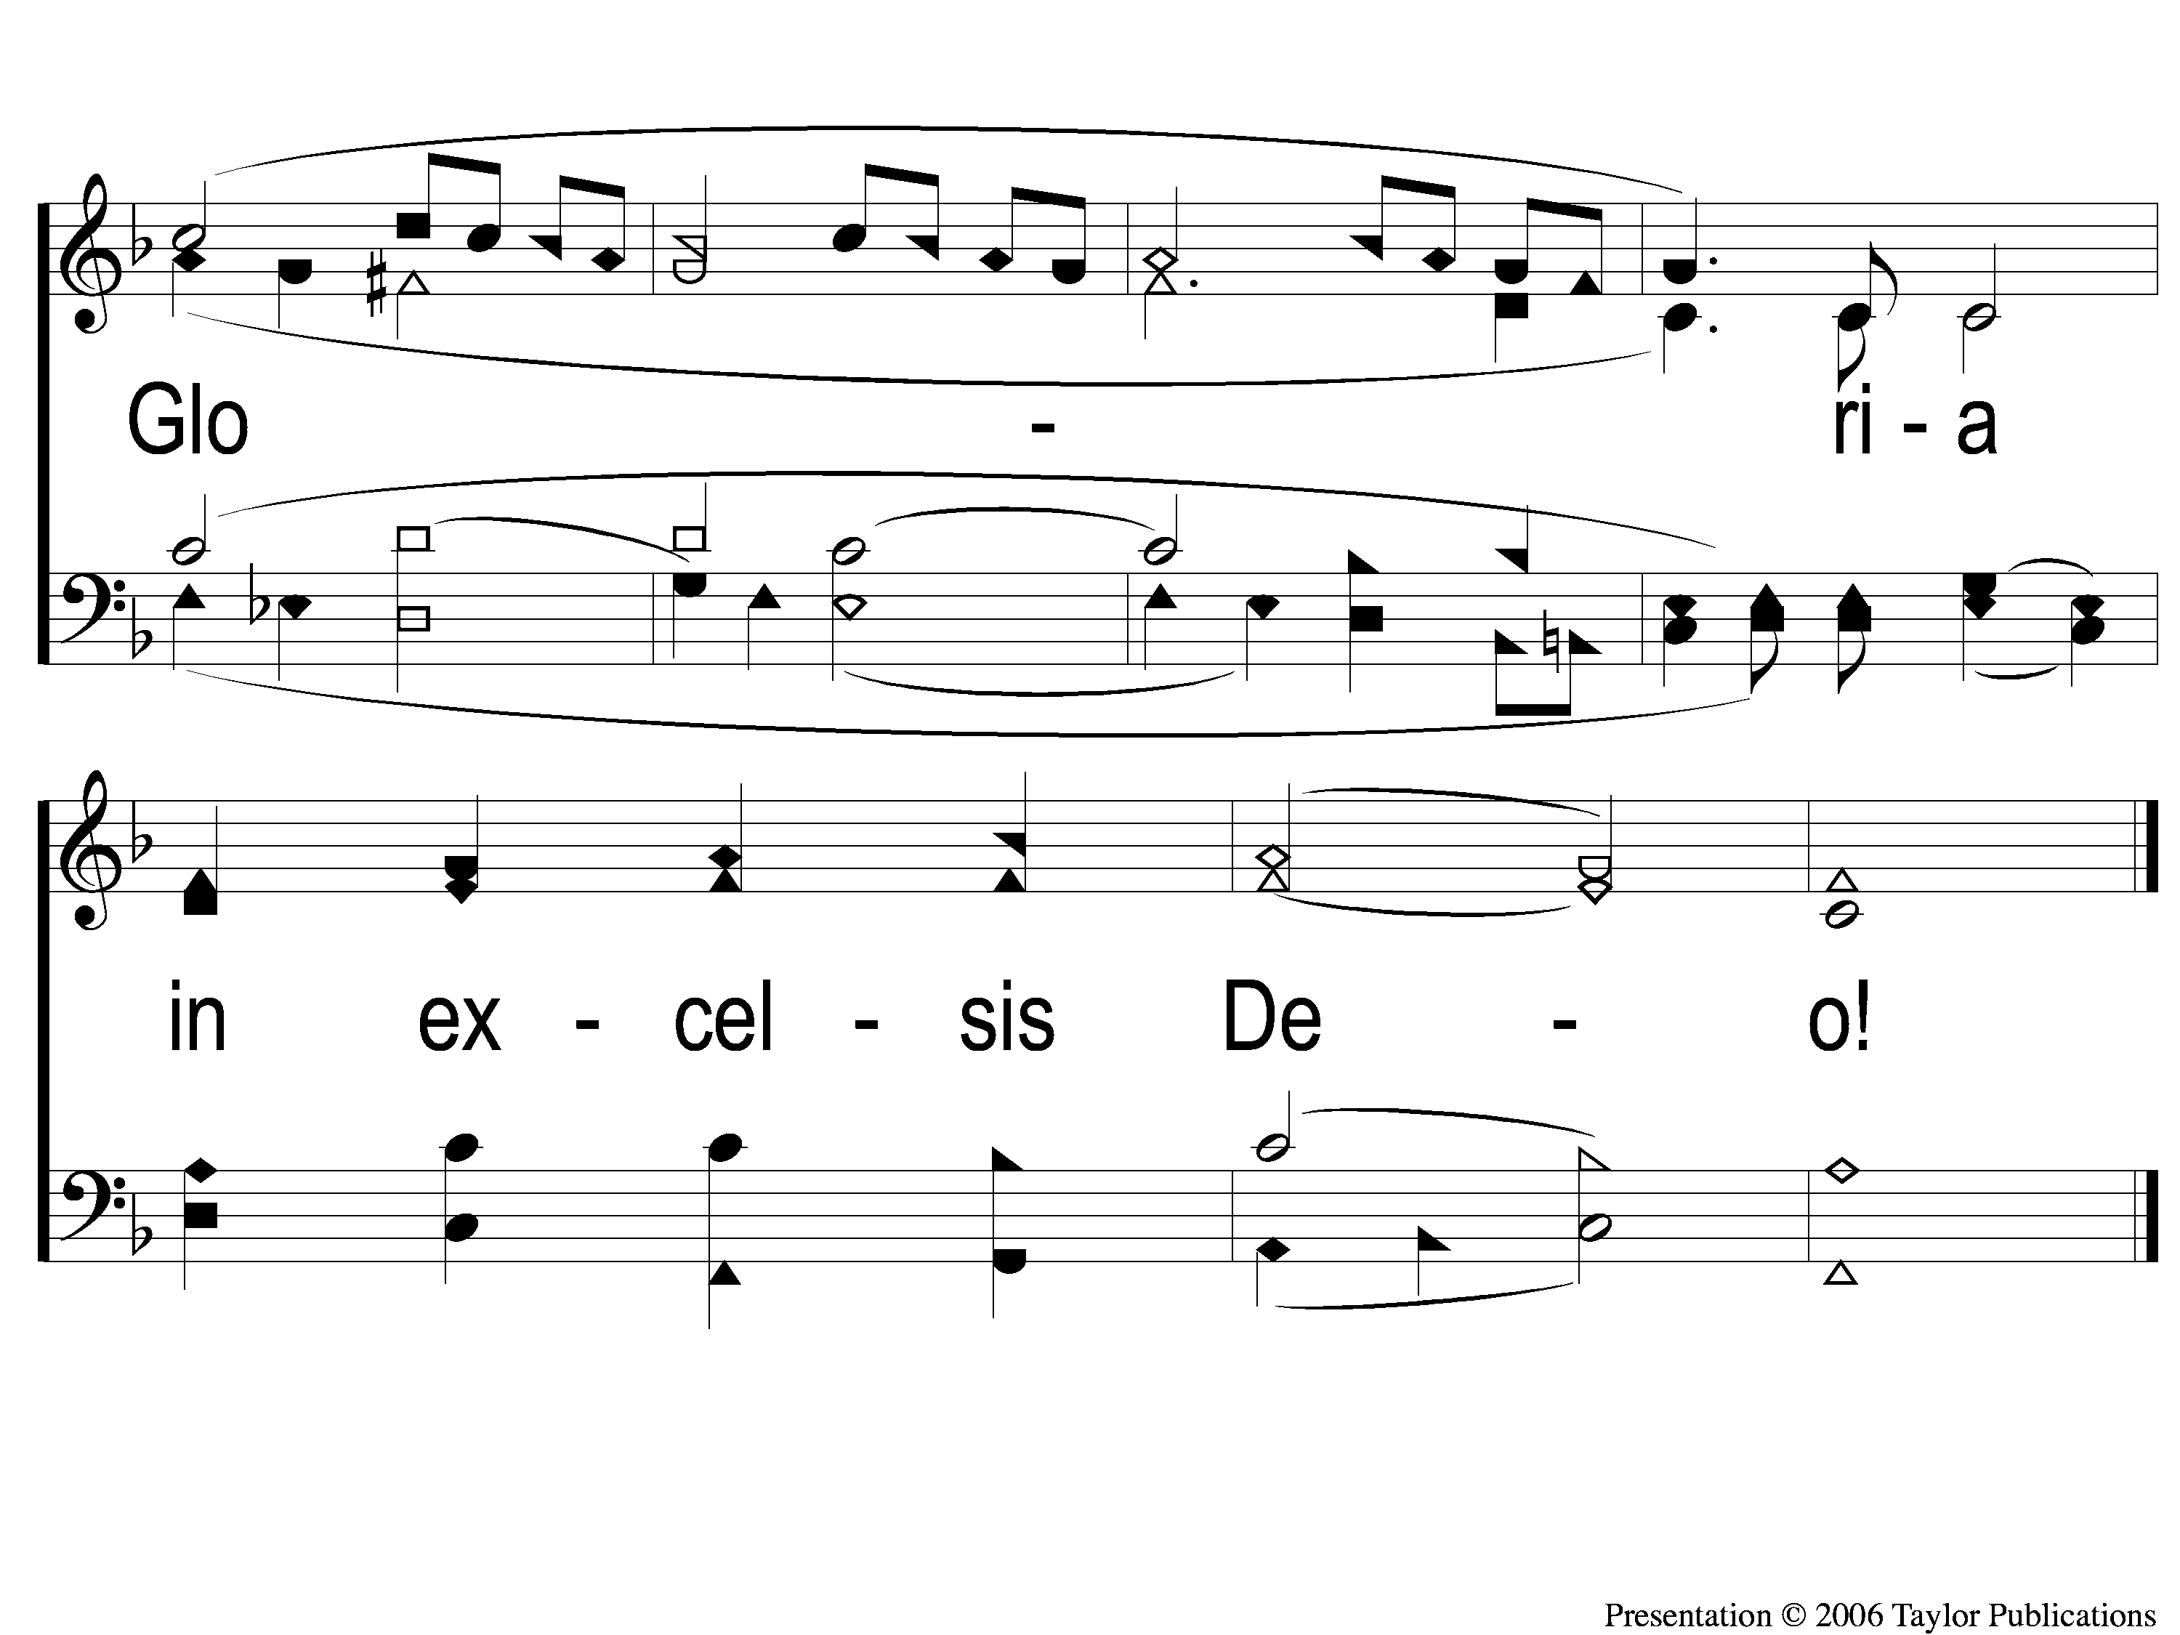
C-2 Angels We Have Heard On High
Angels We Have Heard On High
1002

Slide 5
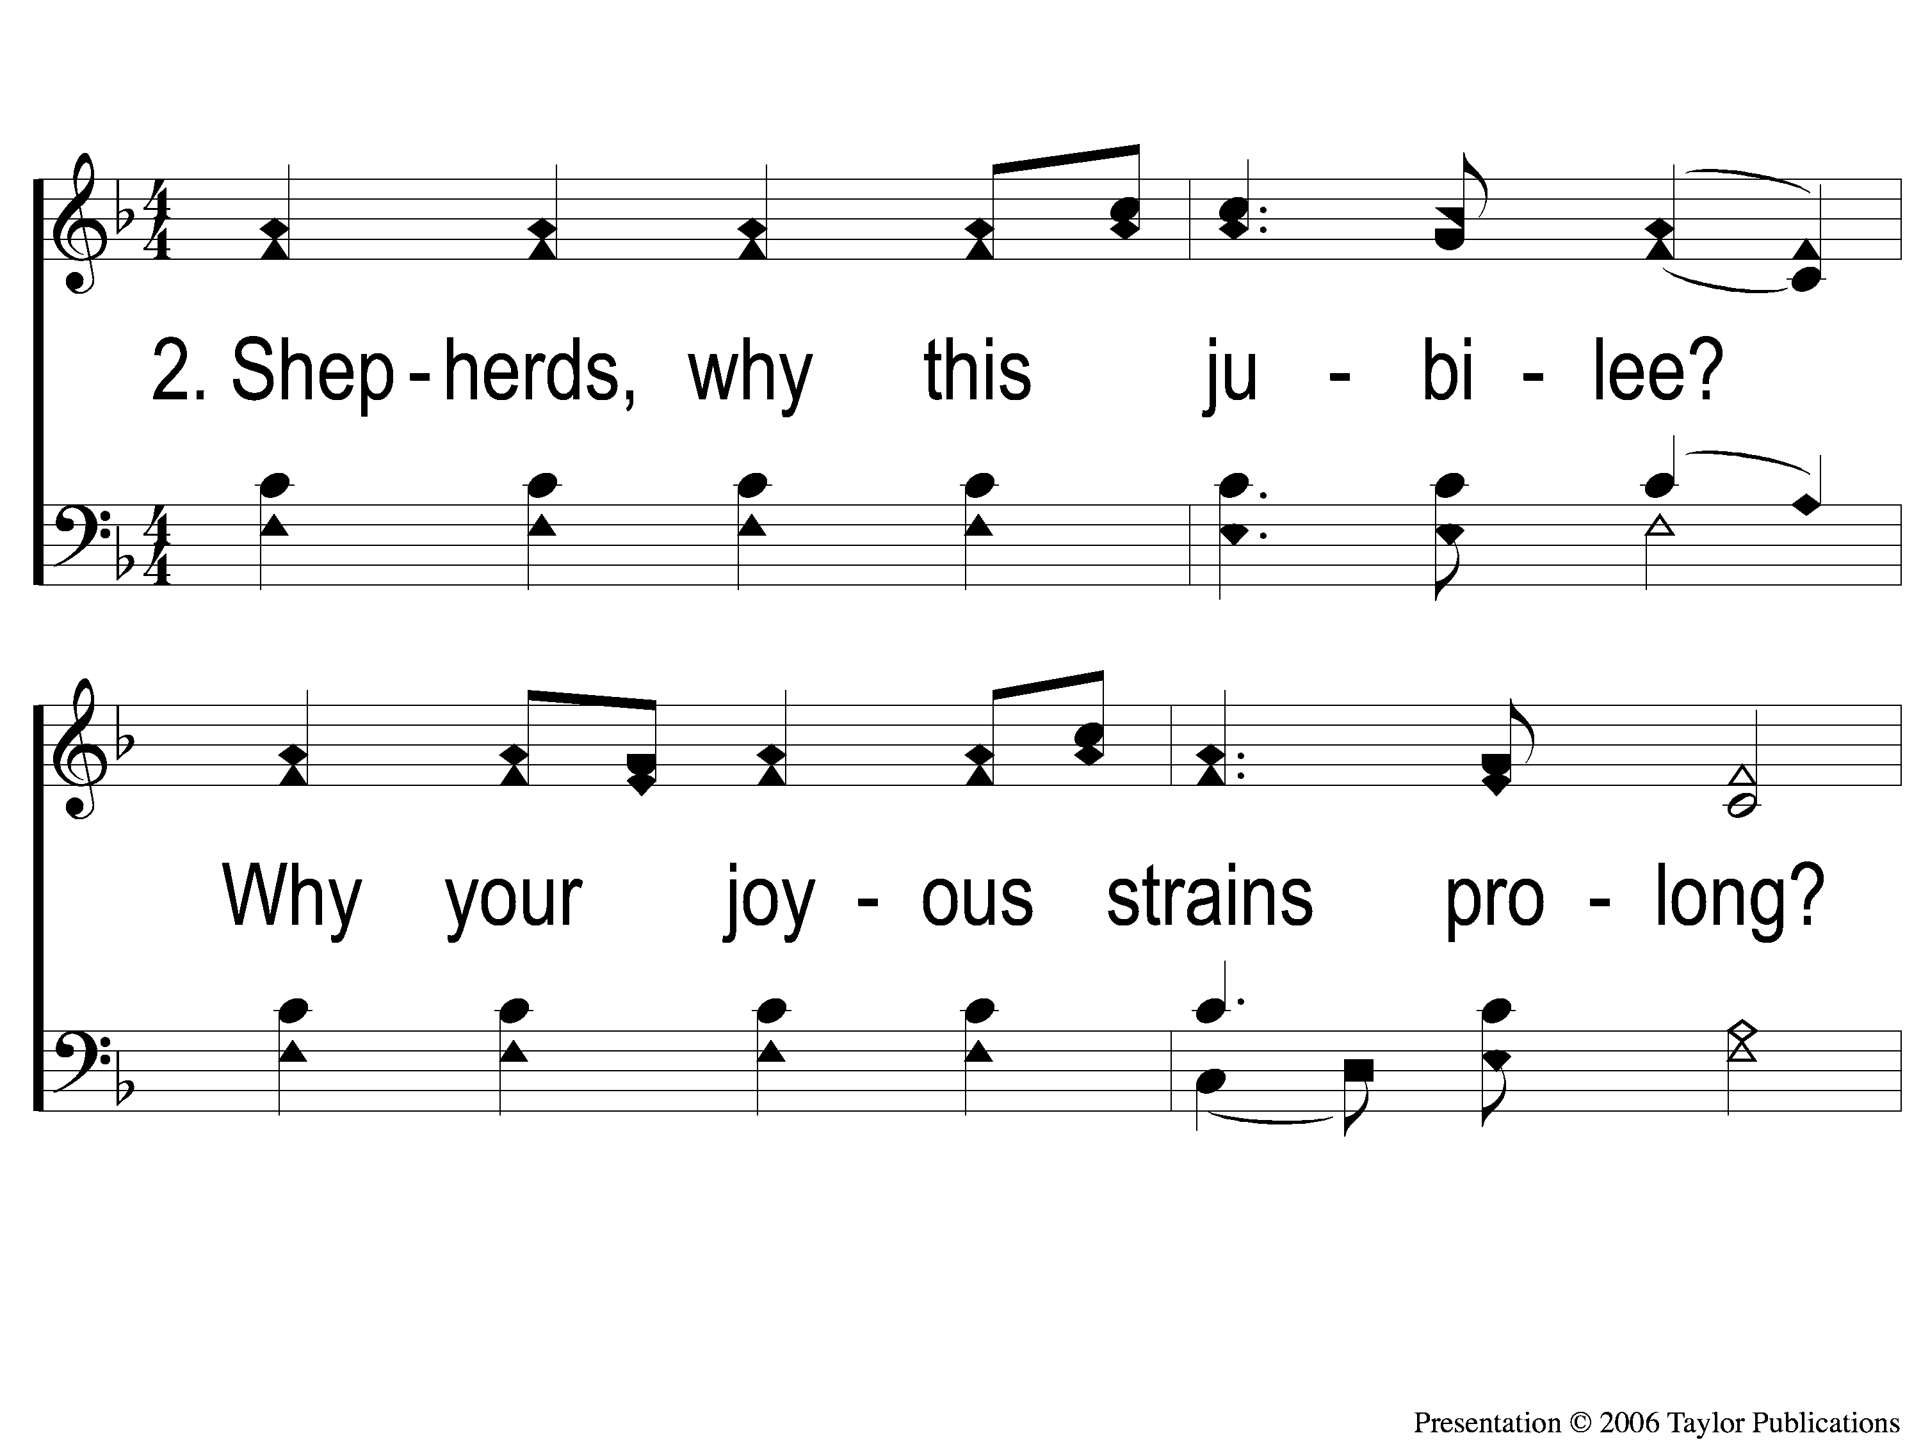
2-1 Angels We Have Heard On High
Angels We Have Heard On High
1002

Slide 6
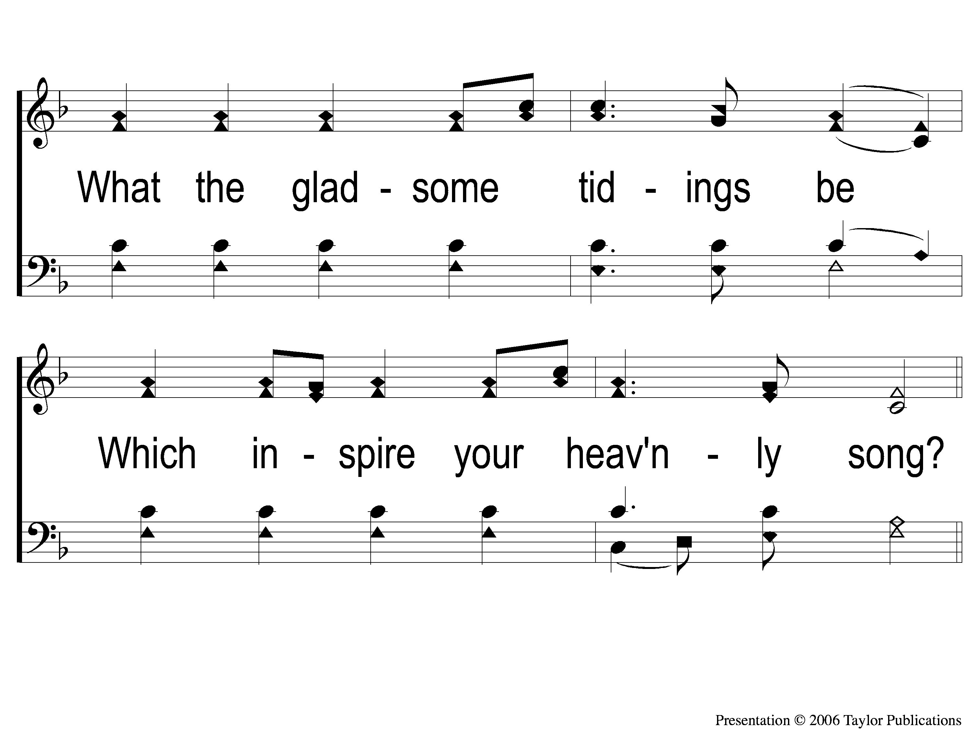
2-2 Angels We Have Heard On High
Angels We Have Heard On High
1002

Slide 7
C-1 Angels We Have Heard On High
Angels We Have Heard On High
1002

Slide 8
C-2 Angels We Have Heard On High
Angels We Have Heard On High
1002

Slide 9
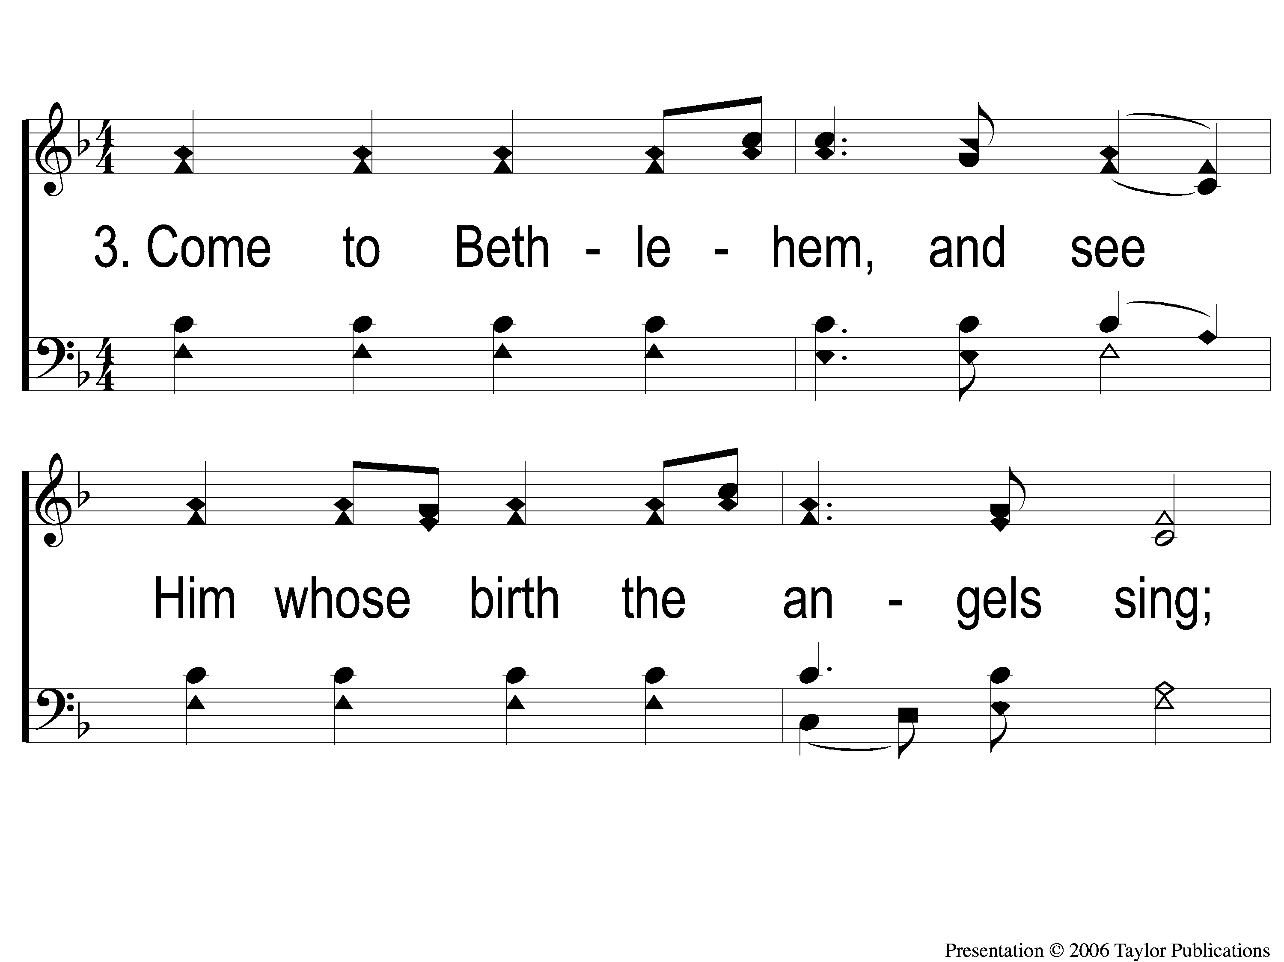
3-1 Angels We Have Heard On High
Angels We Have Heard On High
1002

Slide 10
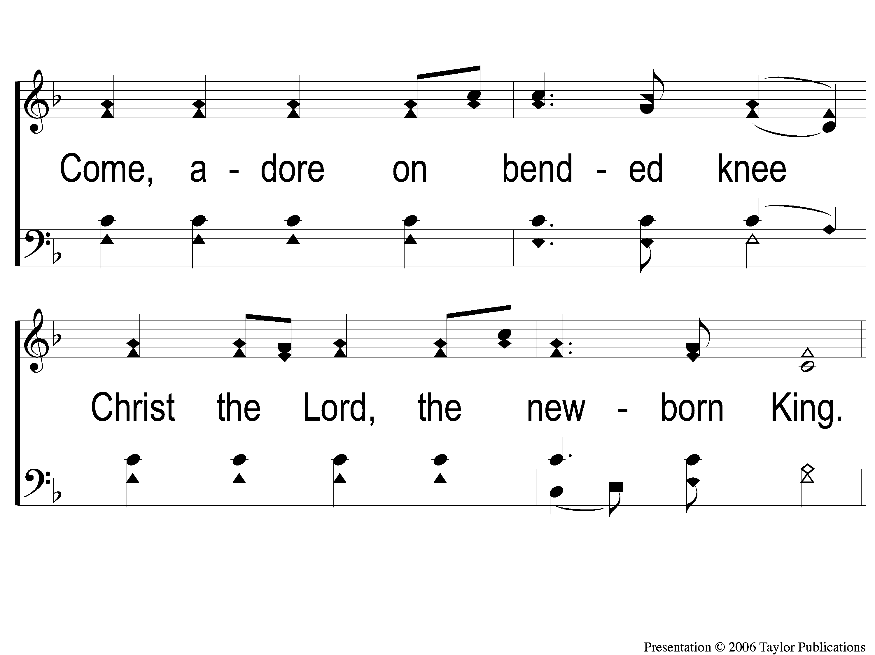
3-2 Angels We Have Heard On High
Angels We Have Heard On High
1002

Slide 11
C-1 Angels We Have Heard On High
Angels We Have Heard On High
1002

Slide 12
C-2 Angels We Have Heard On High
Angels We Have Heard On High
1002

Slide 13
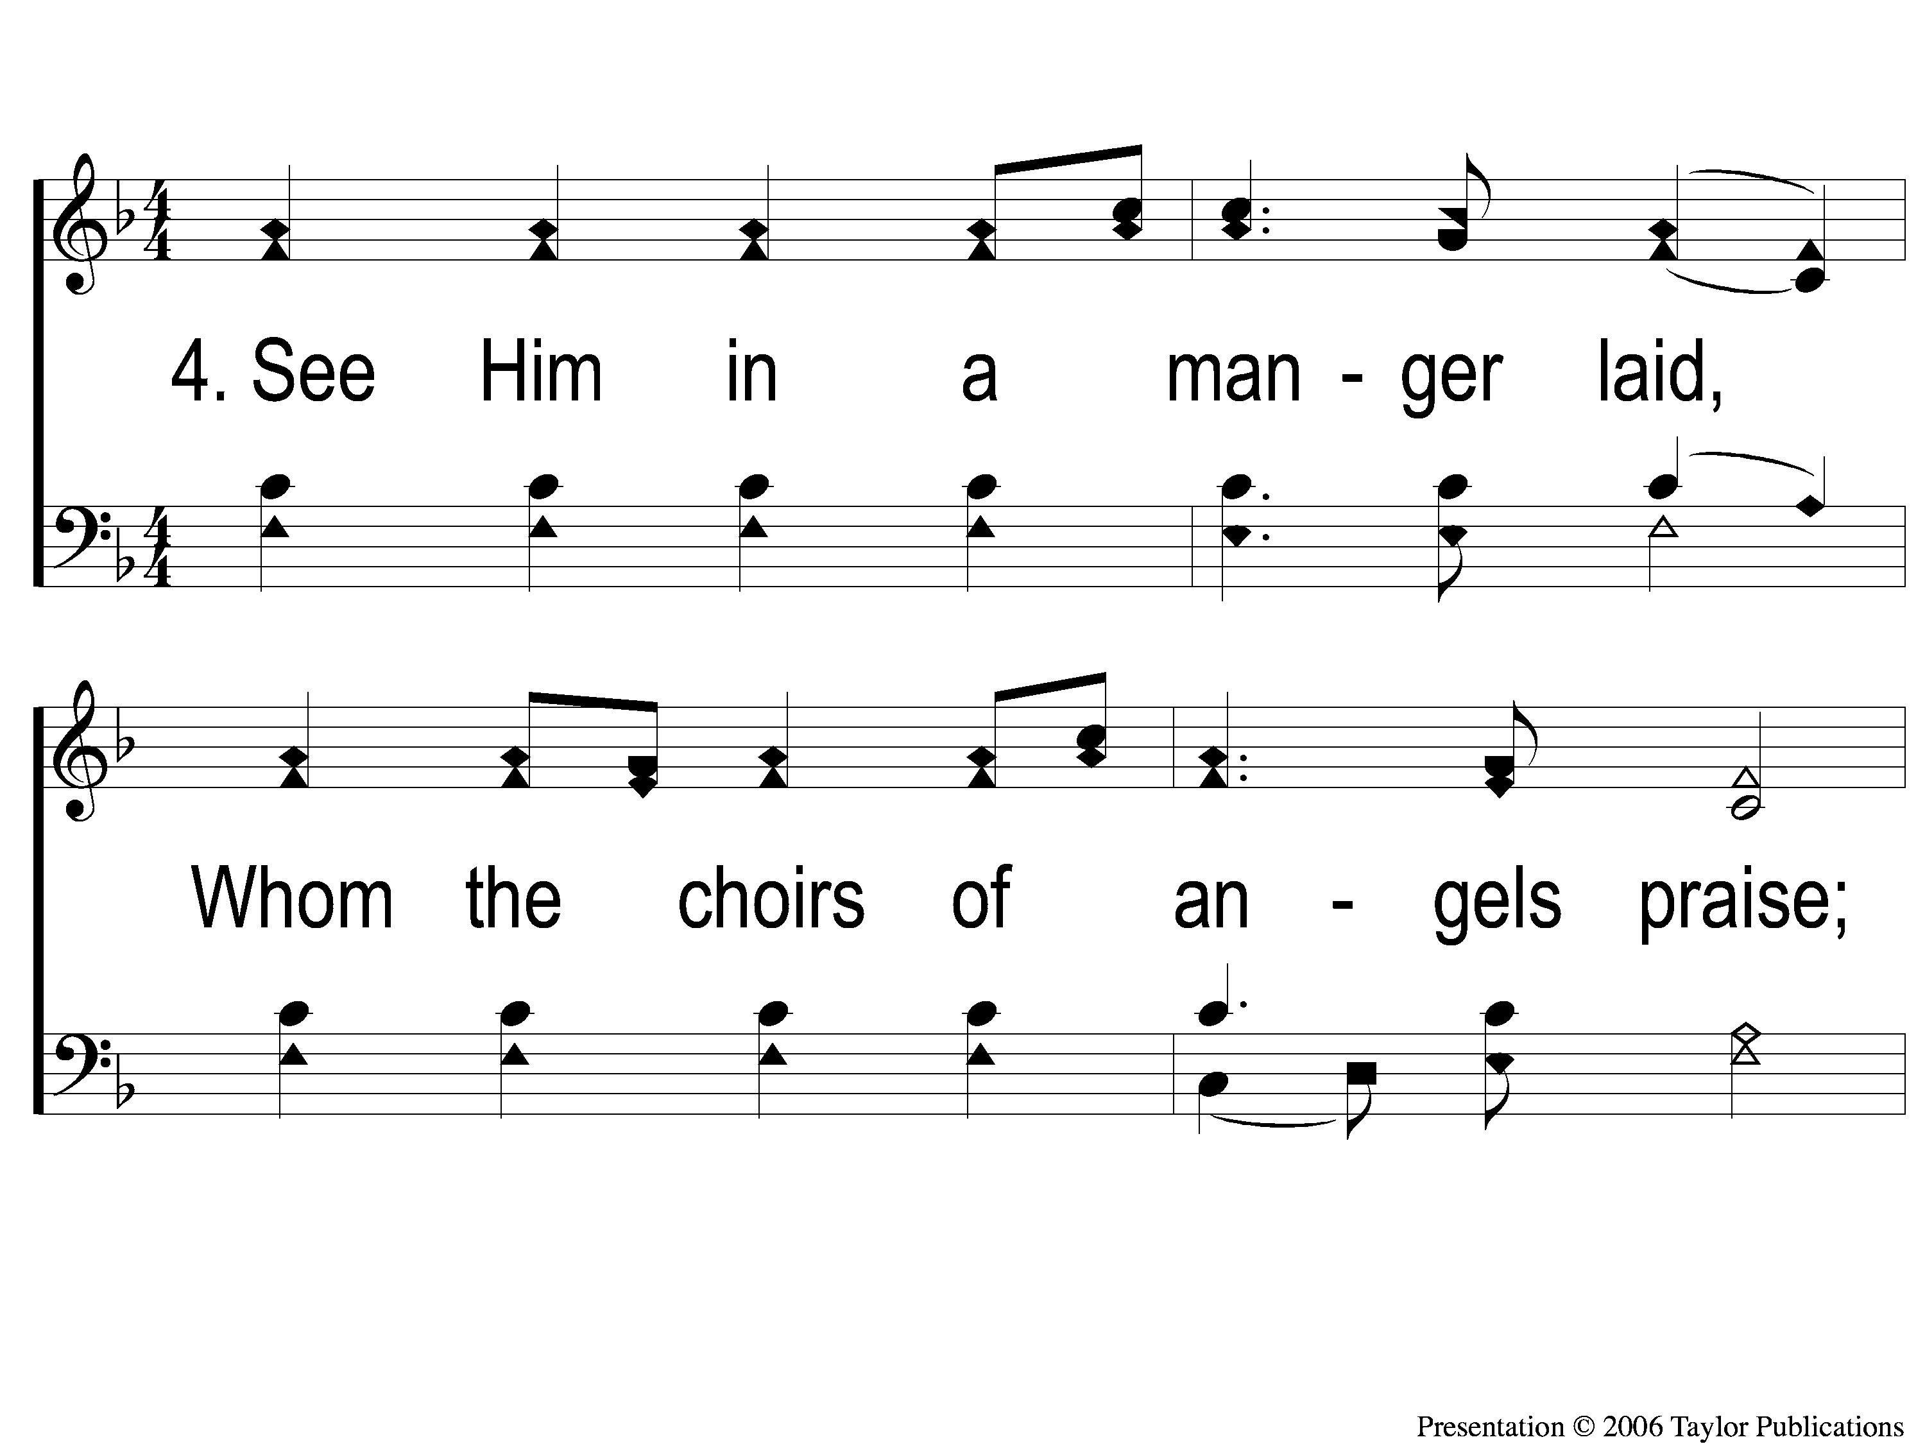
4-1 Angels We Have Heard On High
Angels We Have Heard On High
1002

Slide 14
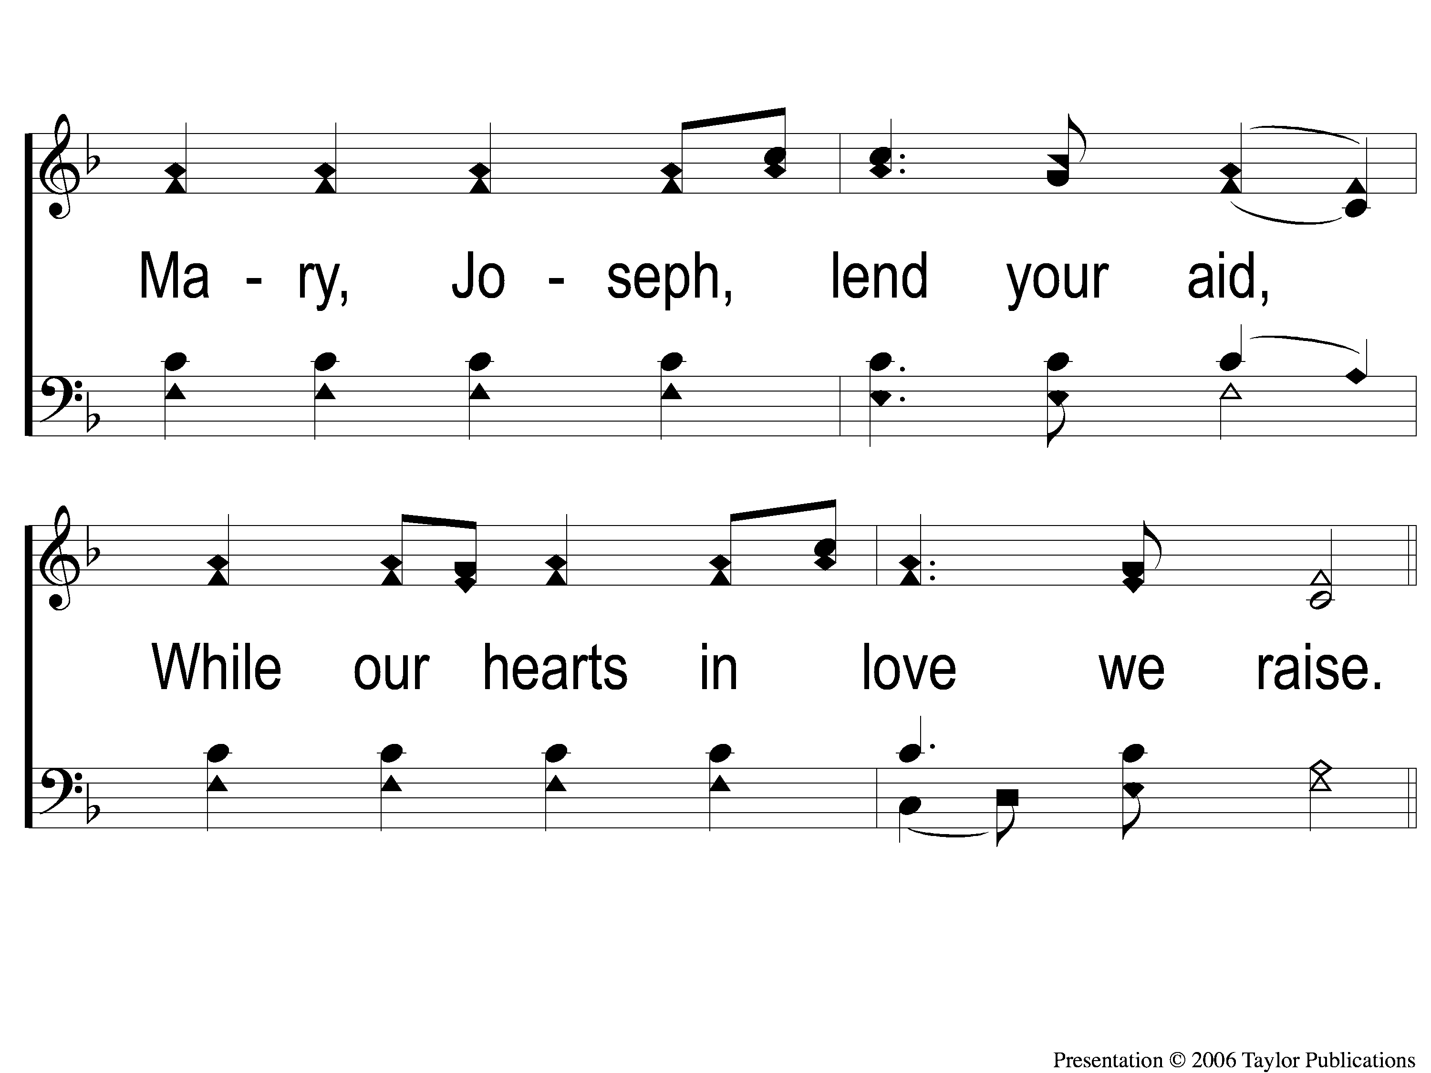
4-2 Angels We Have Heard On High
Angels We Have Heard On High
1002

Slide 15
C-1 Angels We Have Heard On High
Angels We Have Heard On High
1002

Slide 16
C-2 Angels We Have Heard On High
Angels We Have Heard On High
1002

